Slide 1

Sharing makes life beautiful

Slide 2

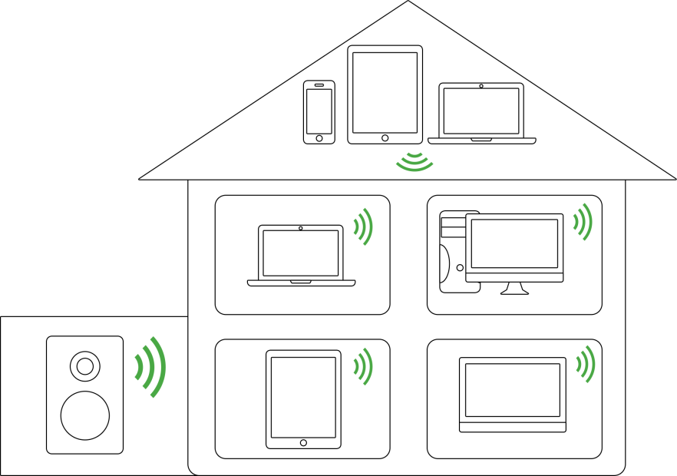
introduction
Sharing media
Arkuda Digital - professional media network applications

Slide 3
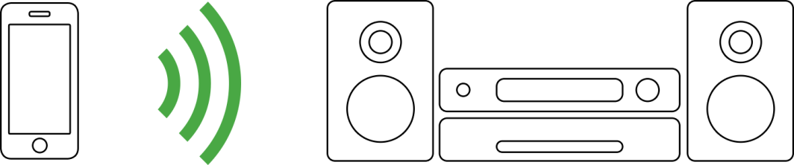
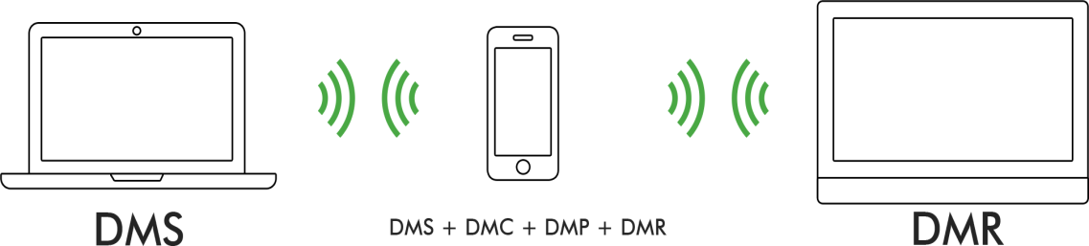
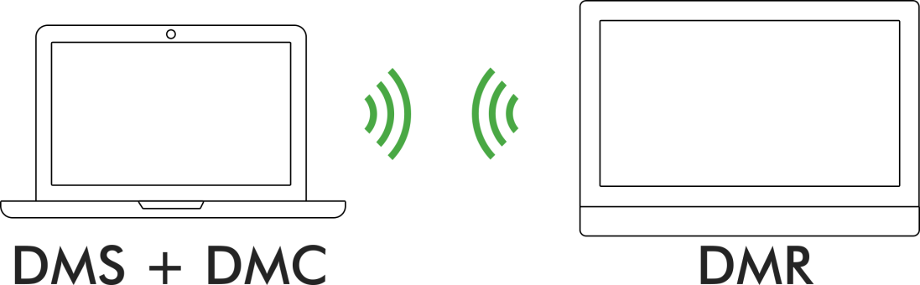
introduction
Sharing media
Music
Video/Movie
Photo
Arkuda Digital - professional media network applications

Slide 4
introduction
Sharing media
Moment to Moment
Device to device
Room to room
Arkuda Digital - professional media network applications

Slide 5

introduction
Sharing media
Media network devices connect, discover and communicate with each other over a home network. Make sure you have Wi-Fi or local connection.
STEP 1
STEP 2
STEP 3
Use reliable media network solutions for easy & fast integration, stable performance, and very good user experience.
Make sure you have UPnP/DLNA/Allshare compatible devices in-house within the same network.
Arkuda Digital - professional media network applications

Slide 6
introduction
Quality factors
Fast integration
Stable performance
Great User experience
Arkuda Digital - professional media network applications

Slide 7
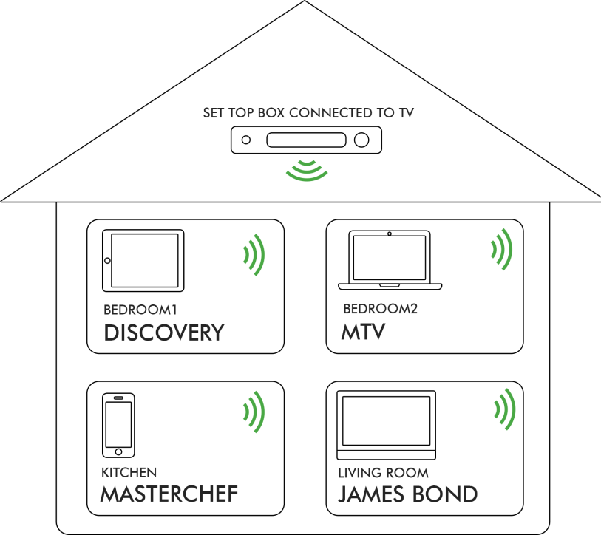
Solutions for
Display Photo, Video, Movie from any compatible device on the TV
Play music from any compatible device on the TV
Display Internet content such as YouTube on the TV
Play internet radio from any compatible device on the TV
Share simultaneously, different TV Channels & VOD to any compatible device
IPTV/OTT integration
Arkuda Digital - professional media network applications

Slide 8
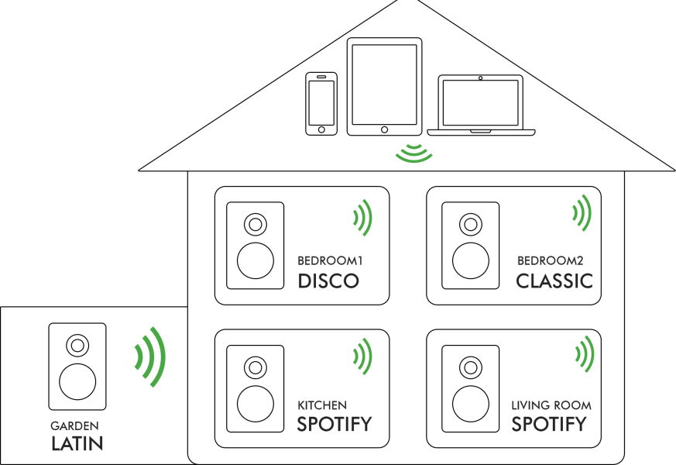
Solutions for
Stream music, stored on mobile, computer or any other server, to any compatible speaker system
Stream internet radio to any compatible speaker system
Arkuda Digital - professional media network applications

Slide 9
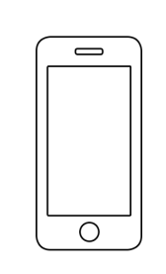
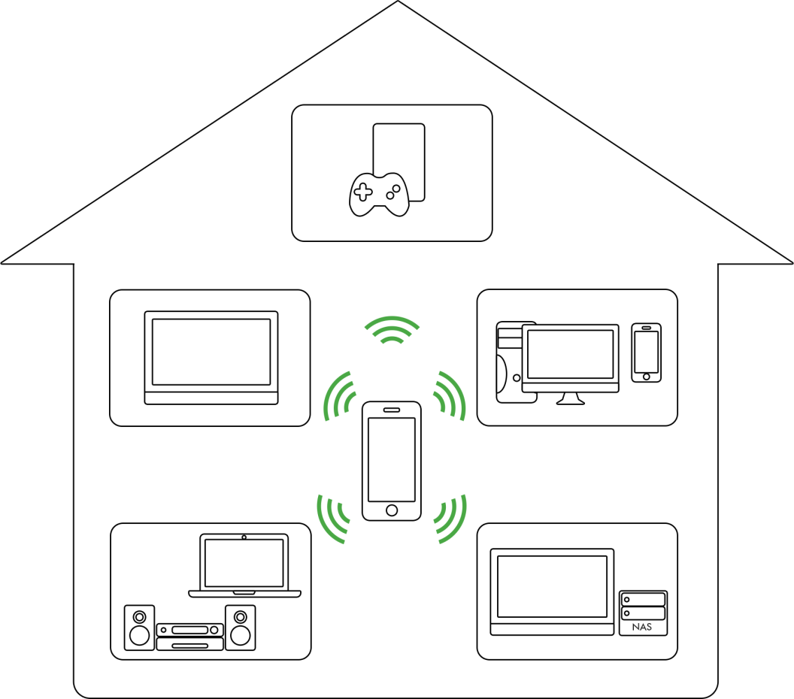
Solutions for
Mobile App for IOS and Android ( Smartphone/tablet)
ArkMC locates media at any compatible device
Locates both online ( YouTube, internet radio) and offline media
Enables streaming media files from PC, STB, Blue-Ray Disc Player, NAS, Digital Cameras, Camcorders and Mobile Devices to TV, Audio, PCs, Media Centers, Game Consoles and Mobile Devices
Arkuda Digital - professional media network applications

Slide 10
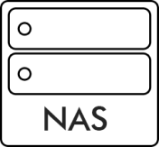

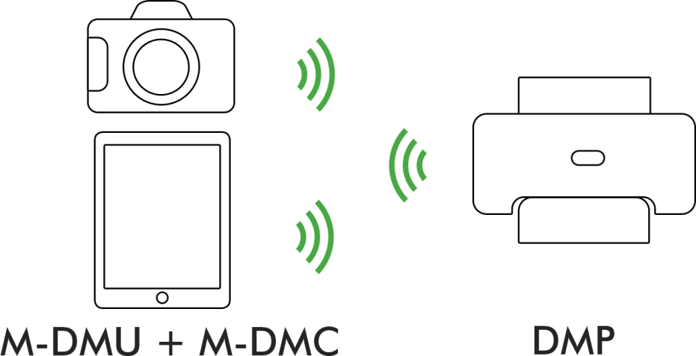


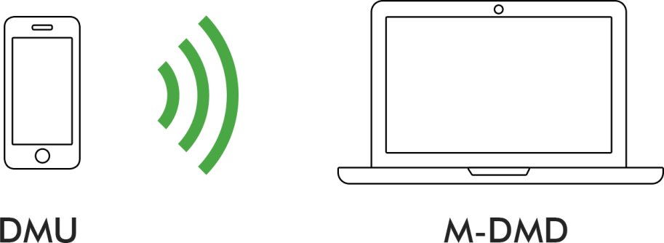
Solutions for
Much more
Arkuda Digital - professional media network applications

Slide 11
Arkuda Digital
Device classes
RENDERER
Media Network
SERVER
PLAYER
CONTROLLER
Arkuda Digital - professional media network applications

Slide 12
Arkuda Digital
RENDERER
Makes itself available for discovering and control in home network
Play media streams from a digital media server (DMS)
Handle commands from remote media network software such as “pause”, “seek”, “change volume” etc
Reports "track duration", "current position" etc. to remote media network software
Windows Media Player “Play-to” support
Third-party players and pipelines integration
Arkuda Digital - professional media network applications

Slide 13
Arkuda Digital
PLAYER
Discovery media servers in home network
Browsing content of a media server, selecting media item (examples: video, audio or photo)
Playback media stream from DMS
Trick mode support
Flexible pipeline support
Third-party players and pipelines integration
Arkuda Digital - professional media network applications

Slide 14
Arkuda Digital
CONTROLLER
Discovering media servers and media renderers in home network
Browsing content of a media server, selecting media item (examples: video,
audio or photo)
Selecting digital media renderer (DMR) and connect it with digital media server (DMS) in order to play selected media from server
Media search, sort, filter
Event subscription and management
Playback and sound control of Renderers in local network
Multiple network interfaces support
Arkuda Digital - professional media network applications

Slide 15
Arkuda Digital
SERVER
Makes itself available for discovering in home network
Exposing and distributing media content throughout the home network
Provides a browsable hierarchy of media resources and streams them on request
Multi-stream video/audio support
Multiple network interfaces support
Arkuda Digital - professional media network applications

Slide 16
Arkuda Digital
services
Tool kits development for media network integration on your devices
Media network module integration to your Operating system
Development of mobile media network applications
IPTV / OTT software development
UPnP/DLNA/Allshare maintenance
Arkuda Digital - professional media network applications

Slide 17
Start a project
6 steps
Reference platform | customer provides all needed information regarding targeted reference platform. First step is a technical meeting where all relevant points will be commented.
Advice | Arkuda will study the information provided and will advise the most suitable solution
SDK Porting | Arkuda will port SDK to target platform and run set of tests
Delivery SDK | The customer will receive the SDK’s (API’s, documentation and binary files)
Integration | As desired, customer and/or Arkuda will integrate the media application into the targeted platform and solution
Support | During integration Arkuda will provide R & D support to secure a smooth process
Arkuda Digital - professional media network applications

Slide 18






Arkuda Digital
The company
Arkuda Digital is a high-end software company, a global provider of wireless Media Network solutions to Consumer Electronics ODM/OEMs, Cable and Telecom Operators, IPTV and STB solution providers and consumers.
Arkuda Digital will make an intellectual contribution to your IT projects, as we had experience with companies: Samsung, Ukrtelekom, U-Media, IMAQLIQ TV, Pocket Book, Fujitsu.
Arkuda Digital - professional UPnP/DLNA applications

Slide 19
Our contacts
Address:
244 5th Ave # 1564
New York, NY 10001
USA
R&D center:
121, Saksaganskogo Street, office 8
Kyiv 01032
Ukraine
Email address:
Sales: sales@arkudadigital.com
General: info@arkudadigital.com
Support: support@arkudadigital.com
Cell: +38(067) 402 11 37
Tel: +1(415)692-5417
Fax: +1(212) 591 60 35
Arkuda Digital - professional UPnP/DLNA applications

Slide 20
Sharing Makes Life Beautiful!
Arkuda Digital - professional UPnP/DLNA applications

